Slide 1
Chapter 12 Exception Handling and Text IO

Slide 2
Objectives
To get an overview of exceptions and exception handling.
To explore the advantages of using exception handling.
To distinguish exception types: checked vs. unchecked.
To declare exceptions in a method header.
To throw exceptions in a method.
To write a try-catch block to handle exceptions.
To obtain information from an exception object.
To use the finally clause in a try-catch block.

Slide 3
Exceptions
Exceptions are runtime errors.
When a program runs into a runtime error, the program terminates abnormally.
Exception handling enables a program to deal with runtime errors and continue its normal execution.

Slide 4
Runtime error
public class Test
{
public static int quotient(int number1, int number2)
{
return number1 / number2;
}
public static void main(String[] args)
{
System.out.println(quotient(15, 0));
System.out.println("Execution continues ...");
}
}
Output
Exception in thread "main" java.lang.ArithmeticException: / by zero

Slide 5
Fix using if-else
public class Test
{
public static int quotient(int number1, int number2)
{
if (number2 == 0)
{
System.out.println("Divisor cannot be zero");
System.exit(1);
}
return number1 / number2;
}
public static void main(String[] args)
{
System.out.println(quotient(15, 0));
System.out.println("Execution continues ...");
}
}
Output: Divisor cannot be zero

Slide 6
Fix using Exception Handling
public class Test{
public static int quotient(int number1, int number2) throws ArithmeticException{
if (number2 == 0)
throw new ArithmeticException("Illegal argument");
return number1 / number2;
}
public static void main(String[] args){
try {
int result = quotient(15, 0);
System.out.println(result);
}
catch (ArithmeticException ex) {
System.out.println("Exception: an integer cannot be divided by zero ");
//System.out.println(ex.getMessage()); //Illegal argument
//System.out.println(ex.toString()); //java.lang.ArithmeticException: Illegal argument
}
System.out.println("Execution continues ...");
}
}
Output:
Exception: an integer cannot be divided by zero
Execution continues ...

Slide 7
Exception Advantages
So you see the advantages of using exception handling
Exception handling enables a program to deal with exceptional situations and continue its normal execution
It enables a method to throw an exception to its caller. Without this capability, a method must handle the exception or terminate the program. You should not let the method terminate the program – the caller should decide whether to terminate the program
Exception handling separates error-handling code from normal programming tasks, thus making programs easier to read and to modify

Slide 8

Exception Types
Checked vs. Unchecked Exceptions
The Object class, in the java.lang package, sits at the top of the class hierarchy tree. Every class is a descendant, direct or indirect, of the Object class.

Slide 9
Checked Exceptions vs. Unchecked Exceptions
RuntimeException, Error and their subclasses are known as unchecked exceptions. Unchecked exceptions can occur anywhere in the program. To avoid cumbersome overuse of try-catch blocks, Java does not mandate you to write code to catch unchecked exceptions.
All other exceptions are known as checked exceptions, meaning that the compiler forces the programmer to check and deal with the exceptions.

Slide 10

Declaring, Throwing, and Catching Exceptions

Slide 11
Declaring & Throwing Exceptions
Every method must state the types of checked exceptions it might throw. This is known as declaring exceptions.
When the program detects an error, the program can create an instance of an appropriate exception type and throw it. This is known as throwing an exception.
public static double computeArea(double radius) throws IllegalArgumentException{
if (radius >= 0)
return Math.PI*radius*radius;
else
throw new IllegalArgumentException("Radius cannot be negative");
}

Slide 12
Catching Exceptions
try {
statements; // Statements that may throw exceptions
}
catch (Exception1 exVar1) {
handler for exception1;
}
catch (Exception2 exVar2) {
handler for exception2;
}
...
catch (ExceptionN exVar3) {
handler for exceptionN;
}

Slide 13
Catching Exceptions Example
public class Test{
public static double computeArea(double radius) throws IllegalArgumentException{
if (radius >= 0)
return Math.PI*radius*radius;
else
throw new IllegalArgumentException("Radius cannot be negative");
}
public static void main(String[] args){
try {
double area = computeArea(-5);
System.out.println(area);
}
catch (IllegalArgumentException ex) {
System.out.println(ex.toString());
}
}
}

Slide 14
The finally Clause
The finally clause is always executed regardless whether an exception occurred or not and even if there is a return statement before reaching the finally block.
try {
statements;
}
catch(TheException ex) {
handling ex;
}
finally {
finalStatements;
}
Finally block can be used to put the “clean-up” code like closing a file or a connection.

Slide 15
Trace a Program Execution
animation
Suppose no exceptions in the statements
try {
statements;
}
catch(TheException ex) {
handling ex;
}
finally {
finalStatements;
}
Next statement;

Slide 16
Trace a Program Execution
animation
The final block is always executed
try {
statements;
}
catch(TheException ex) {
handling ex;
}
finally {
finalStatements;
}
Next statement;

Slide 17
Trace a Program Execution
animation
Next statement in the method is executed
try {
statements;
}
catch(TheException ex) {
handling ex;
}
finally {
finalStatements;
}
Next statement;

Slide 18
Trace a Program Execution
animation
try {
statement1;
statement2;
statement3;
}
catch(Exception1 ex) {
handling ex;
}
finally {
finalStatements;
}
Next statement;
Suppose an exception of type Exception1 is thrown in statement2

Slide 19
Trace a Program Execution
animation
try {
statement1;
statement2;
statement3;
}
catch(Exception1 ex) {
handling ex;
}
finally {
finalStatements;
}
Next statement;
The exception is handled.

Slide 20
Trace a Program Execution
animation
try {
statement1;
statement2;
statement3;
}
catch(Exception1 ex) {
handling ex;
}
finally {
finalStatements;
}
Next statement;
The final block is always executed.

Slide 21
Trace a Program Execution
animation
try {
statement1;
statement2;
statement3;
}
catch(Exception1 ex) {
handling ex;
}
finally {
finalStatements;
}
Next statement;
The next statement in the method is now executed.

Slide 22
When to Use Exceptions
You should use it to deal with unexpected error conditions. Do not use it to deal with simple, expected situations.
Consider the following code:
String s = null;
System.out.println(s.toString());
The above code results in an Exception:
Exception in thread "main" java.lang.NullPointerException

Slide 23
When to Use Exceptions
You could use Exception Handling to handle this error.
String s = null;
try {
System.out.println(s.toString());
}
catch (NullPointerException ex) {
System.out.println("s is null");
}

Slide 24
When to Use Exceptions
But this is a simple, expected case. So, better use if-else to avoid overheads associated with Exception Handling.
if (s != null)
System.out.println(s.toString());
else
System.out.println("s is null");

Slide 25
Defining Custom Exception Classes
Use the exception classes in the API whenever possible.
Define custom exception classes by extending Exception or a subclass of Exception.
We will not discuss more about Custom Exception Classes. If interested, please refer to the book. It’s easy to understand if you have the basic understanding of Object-Oriented Programming.

Slide 26
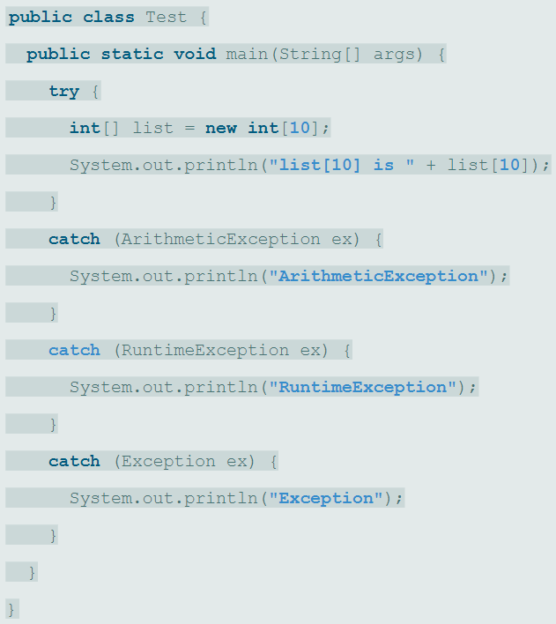
ClassWork
What will be the output?

Slide 27
Practice Exercise
The Triangle Inequality Theorem states that the sum of any two sides is greater than the third side.
Write a Triangle class that has
Data fields to store the three sides (default is 1.0)
a constructor that takes the values of three sides as it's parameters, checks if the triangular inequality theorem is satisfied and assigns the values to the class variables. If the triangular inequality is not satisfied, the constructor throws an exception.
a toString() method that returns the three sides of the triangle.
The main method should create a triangle object and handle the exception by displaying an appropriate message.

